Slide 1
Web Design Bootcamp Lite

Slide 2
Web Site Examples
SBC
Roblox
Amazon
Netflix
JK Rowling's Professional Website
Seventeen Magazine
Facebook

Slide 3
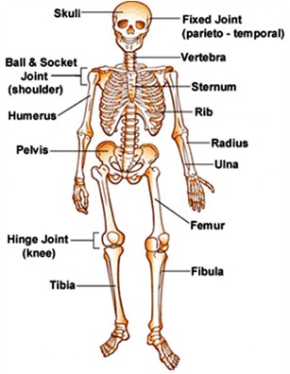
The Structure of Each Website Is HTML
HTML – Hyper Text Markup Language

Slide 4
Are you saying there are bones in my computer?
Instead of bones we use three main pieces for the structure:
The greater than and less than signs: < >
We fill them with abbreviations of names for the part of the body we want to give meaning to. Combined we call these TAGS:
<h1>
<p>
<img>
We then add context and an ending tag </>:
<h1>Harry Potter vs. Darth Vader the Musical!</h1>
The user will only see the words “Harry Potter vs. Darth Vader the Musical!”
And there you have it. A bone in your body. But we call them ELEMENTS.

Slide 5

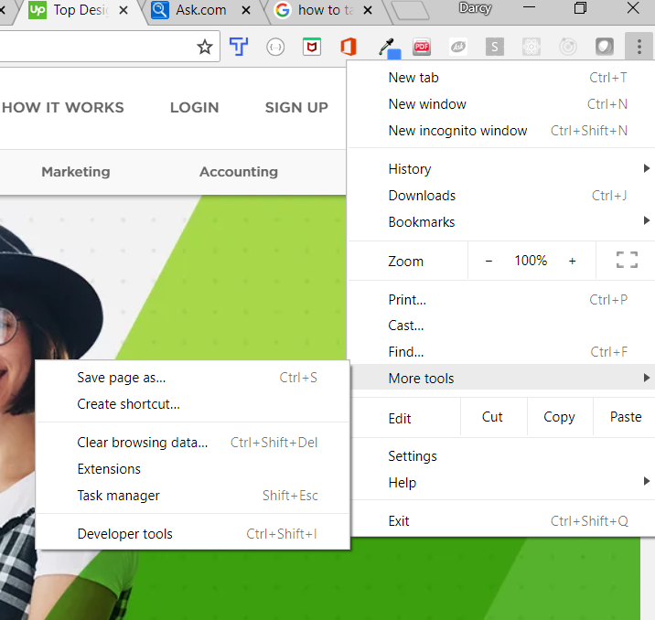
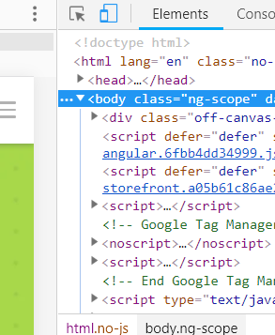
Pick a website and lets look inside at the skeleton!
Open Chrome
Left click on the three small dots in the top-right corner
Click on More Tools
On the new menu click on Developer Tools
A tool box shows on the right of your screen. In the menu make sure Elements is clicked.

Slide 6
Now that you got the basic gist, let’s build something!
We will start with the most common tags:
The heading tags:
<h1> </h1>, <h2> </h2>, So on to <h6>
The paragraph tag:
<p><p>
The anchor tag (used for creating links):
<a></a>
The image tag for photos and other static graphics:
<img /> *Note that the image tag is self closing. We will talk about why later.
The ordered list and unordered list and list tags:
<ol></ol> and <ul></ul> and <li></li>

Slide 7
Text Editor - Brackets
Make a folder called first web page (your initals. Mine is “first web page ddw”.
Open the folder. Right click for menu. Double click on “Open as a Brackets project”.
There are a ton of text editors out there, and their capabilities have a range.
It is a great way to write code in an organized way.
Under where it says the name of your file, right click, choose new file, and name it index.html (standard for the first page in a website)

Slide 8
H1-6 Tag
Another word for title is heading. So, the “h” is for heading. The number after that is its level of importance – with 1 being the most important. The more important, the bigger that text is.
In Brackets type <h1>Best Summer Recipes</h1>
Hold Ctrl + S. This is a quick key for saving! Use often.
The link to the right that looks like a sideways lightning bolt, click on it. Chrome should pop up with your very first landing page.
Check it out in dev tools
Landing page is the first page of any website.

Slide 9
Quiz Time
HTML stands for Hyper Text Markup…?
What do we call all of these: <h1><p><a><ul>
Can you give me an example of an element?
How may levels of headings can we have?
I have a title of a blog called “A Wrinkle in My Time Machine”

Slide 10
Bathroom, Snack, Brainstorm
Come up with some simple recipes together for the summer, so we can put them in our web page.
Remember you need a recipe name, sentence describing the recipe, a list of ingredients, and directions.

Slide 11
Recess!
Come back in 20 minutes!

Slide 12
OK, so now lets plug those ideas into our webpage.
<p></p> : Remember is the paragraph tag. It us used for anything you want to look like regular text so it doesn’t HAVE to be a multi-line paragraph
<ol></ol> is an ordered list. Usually something we might number, like directions
<ul></ul> is an unordered list. Usually something that doesn’t have to be in any order, but just points
<li></li> are the list of items you put inside an ordered list or unordered list.
We will look at the anchor <a></a> tag and image <img></img> later
Lets inspect it in dev tools!

Slide 13
Quiz Time
I described that my time machine is “Young at heart, but getting on in years.”
I need to make a top 2 reasons to keep my time machine, in order of most important to least
I need to list 2 particular things I want in a new time machine, but the order doesn’t matter
I need the top 2 reason list items to be “Love”, “Sentiment”
I need the list of wants to be “Wrinkle Free”, “Smells Good”

Slide 14
Lunch
Go outside, eat lunch, play

Slide 15
Think about it like a report, or magazine article
Using the article in front of you, which is a review of the movie Ocean’s 8, see if you can guess what is considered a heading, and paragraph, a link, an image, and a list.
Use a pencil to draw the tags around each item. Don’t forget the closing tags!
Don’t worry if you have trouble.
The list will be the hardest as it doesn’t look like a list at all. And you have to decide if you think it is an ordered list or unordered list.
When we are done we will check ourselves with dev tools.

Slide 16
Anchor Tag
The anchor tag <a></a> can be used to make a link to another web page.
It has an attribute called href. Think hypertext reference because it references another webpage using hypertext (remember Hyper Text Markup Language).
Href is followed by =“the web address name” and is inside the tags.
If we wanted to link google to our web page we would write it like this:
<a href=“www.google.com”>Google</a>
In our recipes page, at the end, let’s write a paragraph “Find more great recipes here:”
Add an anchor tag with www.allrecipes.com as the href, and Allrecipes as the text the user will see

Slide 17
Anchor tags with UL and LI as Navigation
We will go further into this in a couple of days but know that any navigation bar in a web site is made up of these three things:
<ul>
<li>
<a>
The <a> is wrapped around the text in the list item <li> tag with a href equaling the destination of the link.

Slide 18
Img Tag
The image tag <img /> tells the user to put up an image.
There are 2 common attributes:
src=“source or location of your image”. Think of the word source
alt=“Word or name to describe image just in case the image doesn’t show”. Think of it being the alternate thing someone sees if the image is not there.
We write it like this <img src=“my_dog.jpeg” alt=“My Dog” />
Can anyone guess why we close the img tag in the opening tag?
We are going to grab an image of lemonade from the internet, save it, and put it in our webpage. Go to google.com, type lemonade image, right click, save image as, the go to your project folder and name it lemonade.jpeg and save.
Choose where you would like your lemonade image to be on your web page.

Slide 19
Quiz Time
What is an anchor tag?
I want to hypertext reference the movie theater website Cinemark.com
What is an image tag?
I want the image to be from the source incredibles2
I want the image to have an alternate text of Incredibles 2 Movie in case the image does not show

Slide 20
Let’s head to the movies!!!
Homework: I want you to think about a web page you want to build, because you will be building it tomorrow with my supervision.
Try to keep it simple, something you can build in a day. It may look a little plain, but we will style it on Friday!

Slide 21
Web Design Bootcamp Lite Day 2

Slide 22
Attributes and Values Explained
All HTML elements can have attributes
Attributes provide additional information about an element
Attributes are always specified in the start tag
Attributes usually come in name/value pairs like: name="value"
<a href="https://www.w3schools.com">This is a link</a>
<img src="img_girl.jpg" alt="Girl with a jacket">

Slide 23
The style Attribute
The style attribute is used to specify the styling of a element, like color
Below style is the attribute, color is the property, and red is the value
<p style="color:red">I am a paragraph</p>

Slide 24
The style Attribute
Removing the dots and numbers from <ul> and <ol> .
<ul style="list-style-type: none">
<li>sugar</li>
<li>flour</li>
<li>vanilla extract</li>
</ul>

Slide 25
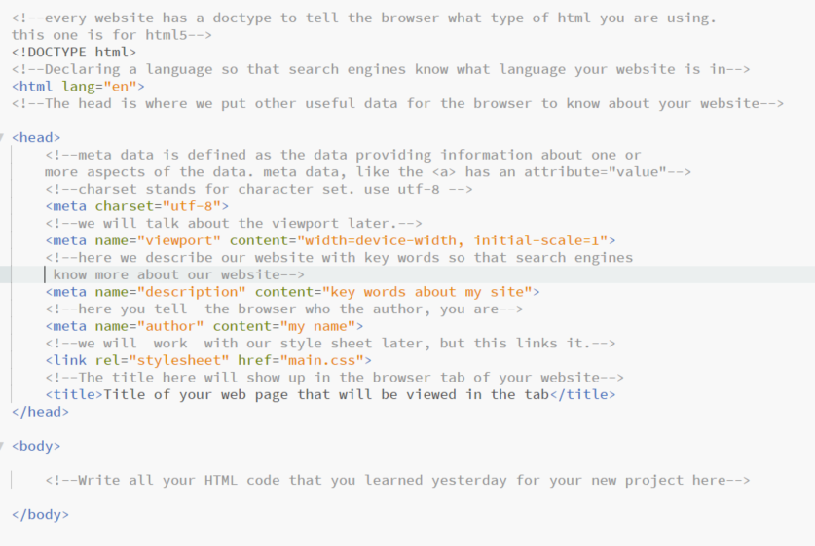

Slide 26
Multi-page website
Within the same project folder simply make a new .html file
Instead of naming it index.html give it a one or two word name descriptive of what it is for like about.html or history.html
Then do everything you did before
We will learn how to link them together with the <a> tag later

Slide 27
Web Design Bootcamp Lite Day 3

Slide 28
Styling
There are 3 ways to style a web page
Inside the html opening tag like this <p style=“color:red”>
Inside the head after the meta data like this:
<head> <style> h1 {color:red;} p {color:blue;} </style> </head>
Or in a Style Sheet. If you have a style sheet, it will override any styling in the head or inside the opening tags.

Slide 29
CSS – Cascading Style Sheet
CSS describes how HTML elements are to be displayed on screen, paper, or in other media
CSS saves a lot of work. It can control the layout of multiple web pages all at once
External stylesheets are stored in CSS files

Slide 30
Applying This To Our Recipes Project
Take your basecode from your personal project, copy it into your recipe index.html, and move all your recipe code between the <body></body>
Take out the “style” attribute we played around with yesterday in the ingredient <ul> so it doesn’t have a style attribute anymore
In the head there is a link that looks like this:
<link rel="stylesheet" href="main.css">
This is telling the browser that you have a stylesheet and the name of that style sheet is main.css.

Slide 31
Create a Style Sheet
In your folder that we made the first day, open it as a brackets project
Create a new file named main.css. This is the main.css we are referring to in the <link> tag in the index.html file

Slide 32
How to Write Styles for Your Elements
The basic way is to use the tag name (in CSS we call it a selector because it “selects”), then create an open and closed curly bracket:
h1 {
}
Inside the selector we will put the property and the value of that property:
h1 {
color: orange;
}
*Note that everything is lowercase and each value ends with a semi-colon
Try It

Slide 33
Common Style Properties
color
background-color
background-image
width
height
list-style-type

Slide 34
Font Color and Background Color
color will change the font (words) of the element color only
Colors can be written often times by its name:
h1 {
color: red;
}
Or as a hexadecimal:
h1 {
color: #E12E4B;
}
*we can also use RBG, but I won’t be teaching it
background-color are very similar to colors but changes the background of the element
Colors can be written often times by its name:
h1 {
background-color: aliceblue;
}
Or as a hexadecimal:
h1 {
color: #f0f8ff;
}
*we can also use RBG, but I won’t be teaching it

Slide 35
Hexidecimals
Let’s try both in our Recipe project first
The easiest way to explain hexidecimals is that there are always 6 numbers and letters (there can be three, but lets pretend there are always six).
Each space can be a number from 0-9 or letter from a-f (and each one represents a number – but we wont go into that)
0 = no color and comes out black, and f = all color and comes out white
The numbers are in pairs and represent red, green, and blue
000000 would mean no red, no green and no blue – thus black
ffffff would mean all red (255), all green (255) and all blue (255) – thus white
So, the right combination of these colors gets you the exact color you want.
You must put a hash before hexidecimals like so: #ffffff

Slide 36
Let’s add some more colors to our project
body {
background-color: #F9E54E;
}
h2 {
color: #f8981d;
}

Slide 37
But we want it blue in the middle, yellow on the sides. Do I make the same background color for all the tags I have? No. Instead we can make that all one big section, and just style that section. After the opening <body> tag add a <section> tag and move the closing </section> tag just before the closing </body> tag Next in your CSS type the following: section { background-color: aliceblue; }

Slide 38
Great. But we don’t have a lot of content, and when its on a large screen it looks funny. Often designers set a size to their screen, and 960px width is a good width. Next in your CSS type the following in the same section selector: max-width: 960px; *We use max-width and not width because on screens smaller than 960, we don’t want everything in the section to get too small to read. Test it out in devtools.

Slide 39
Think about colors for your personal site
http://www.color-hex.com/
Pick a color you like, then scroll down for different tints, shades, and their triadic, analogous, and complementary colors.

Slide 40
Awesome. But now everything is moved to the right! Yes. So just like reading a book, everything starts to the left. So, when we told the computer that we didn’t want anything bigger than 960px, and the screen got bigger than that, it just automatically made anything to the right a margin size of what ever pixels were left! We could add different margins to the section selector like: margin-left: 10px; margin-right: 10px; (you can also do top and bottom) But that won’t center it. To center a section like this simply type: margin: auto;

Slide 41
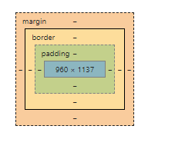
Much better. But the words are right up against the sides! Every element has the potential to have a padding, a border and a margin. The padding is inside the element. The margin is outside the element. So, if we add padding to the section tag through the section selector than padding will go between the sides of the section and all the content inside: Try: Padding: 10px; Feel free to try different sizes. 10px will add to all sides.

Slide 42
Web Design Bootcamp Lite Day 4

Slide 43
Next, let’s insert a background image!
Remember the <img/> tag that we put in the HTML? While we can style that, those large images you see in the background, those are called background images. And we DONOT put them in the html… directly
Background images need a space to fill so, we need to create a space
In the HTML, just below the h1, make a divided section with the <div></div> tag

Slide 44
Styling the Div with our Background Image
Type selector: div {
}
Insert the location of your image I give you:
background-image: url(“watermelon-pops.jpg”);
But there’s no image and I typed everything correctly!
That’s because the picture is suppose to fill the <div> area, but there is no height to the div. The size of the div controls the height of the image, for as long as the image is big enough in pixels.
Inside the div selector also add height:250px; px stands for pixels

Slide 45
Play with it and see what happens
background-attachement: scroll
background-attachement: fixed
background-postion: center
background-repeat: no-repeat
Keep going. You can see more options at:
https://www.w3schools.com/css/css_background.asp
Image scrolls with element
Image stays visible
Image is positioned in the center of the element it is in.
background image will no repeat to fill space

Slide 46
One more thing about height:
When you look at your device you have a certain number of pixels in height that you can view. We call the area you can view the “viewport”.
We call the height of the viewport the “viewport height”.
Instead of telling the computer how tall you want your image or other elements to be based on pixels, you can use vh for viewport height as a percentage.
For example, if you set your div for the image to height: 80vh, it would stretch the image to be that tall.
Try it:
div {
height: 80vh;
}

Slide 47
Now that you played around…
Let’s make the div for that background image have the following style:
div {
background-image: url("watermellon-pops.jpg");
background-repeat: no-repeat;
background-position: center;
background-attachment: scroll;
height: 250px;
}

Slide 48
Image width
Add the cupcake and lemonade images to your html just below the </ol> of each recipe.
You can set the image width to be a static width like so:
img {
width: 300px;
}
You can set it to be responsive by setting a width and max-width so the size changes as the screen gets smaller:
img {
max-width: 400px
width: 100%;
}
This above way is great because it says, hey, make my image always 100% (or whatever percent you give) of the width of the screen, until the image reaches this size. Then stop!

Slide 49
I like my pictures under my recipes on small screens, but how do I get them to sit next to the recipe on bit screens?
Open up dev tools. You will see that your h1-h6, paragraph, div etc take up a whole line without being told to. This is a block element. You could say they take up the whole block.
Your <a> and <img> are inline elements. They only take up the space they need. That is why you can easily do this:
<p> This is my <a>favorite site</a><p>
And not end up with it broken on several lines.
But, we can’t just nest our image like <p> here is an image <img/></p>. It would look odd. So instead we make the block element… inline-block. Then give it a certain width so it makes room for the image.

Slide 50
Make ingredients share the width with img
Add a <div> </div> around each recipe, leaving out the image below it.
Go to your main.css…
Wait, we already have a <div></div> for our large header image of watermelon pops. What do we do?
We can’t have two of the selector in our CSS unless we were actually targeting the same exact tag in our html. And we can’t add different styles to the last div selector because then it will make those changes to all divs, even those we don’t want to…

Slide 51
This is where the class attribute comes in
Think of class like a category, and we give that category a value.
We declare a class inside the opening tag like this:
<div class=“backgroundImage”>
Add this class to the div for your background image
We use the class as a selector in CSS by adding a dot before it like this:
.backgroundImage
In your CSS replace the div selector for the background image with the class like this:
.backgroundImage {
background-image: url("watermellon-pops.jpg");
background-repeat: no-repeat;
background-position: center;
background-attachment: scroll;
height: 250px;
}

Slide 52
Add a class for your recipe divs
For each recipe add “recipe” as the class like so:
<div class="recipe">
<h3>Lemonade</h3>
<p>Sweet and cold drink that anyone would love.</p>
<ul>
<li>
lemons
</li>
<li>
simple syrup
</li>
</ul>
<ol>
<li>Boil Water</li>
<li>Add sugar</li>
<li>Add lemon juice</li>
</ol>
</div>

Slide 53
Add the recipe selector to the CSS
.recipe {
width: 50%;
display: inline-block;
}
*the display property is where we declare if the element will display along the entire width(block) or only its own space(inline), or in this case use only its own space but can still also have a width and height styled for them (inline-block).

Slide 54
And here is the last thing I teach you…
I have been teaching you to use width:100% and so on so that your site also looks good on mobile.
People want to see that you can build what we call “mobile first” design.
If we just plug in our .recipe {width: 50%; display: inline-block; } then our images will always be right next to our recipes on small screens, and that sort of looks bad. (check it out in dev tools).
Instead, we want it to only be that way on big screens. Small screens it looks better at the bottom!

Slide 55
@media queries at a glance
@media allows us to give special rules when the device meets a certain criteria. I will teach you one of the many potential options.
At the very bottom of your CSS type the following:
@media only screen and (min-width: 769px) {
}
Then cut the .recipe { width: 50%; display: inline-block;} and put it inside the @media query brackets
Save and open dev tools. Every time you get as small as the iPad (which is 768px wide) the image is below the text, but any bigger and the image floats to the right of the text!
Media queries are very powerful in design and there is a lot to learn from them, check out the resources to learn more.

Slide 56
Resources
https://www.w3schools.com/
https://www.w3schools.com/html/default.asp
https://www.w3schools.com/css/default.asp
http://www.color-hex.com/
https://www.w3schools.com/css/css3_mediaqueries.asp

